Slide 1
SPOONS ‘N’ FORKS
September 2016

Slide 2
Team Overview
Name | Batch
Janaki Ranjani | NXN API 16 | Database development and maintenance
Madhumathi | NXN API 16 | Integration
Suwetha | NXN API 16 | Angular js Front end development
Ashok | NXN API 16 | RESTful services development

Slide 3
REST services Used
/order (POST)
/order (PUT)
/order/<id> (GET)
/order/<id> (DELETE)

Slide 4
BUTTONS
There are 5 buttons placed on the screen.Clicking on each performs the corresponding task.
1.MENU
2.PLACE AN ORDER
3.DELETE ORDER
4.UPDATE ORDER
5.VIEW YOUR ORDER

Slide 5
CONTENTS
SLIDE NUMBER | CONTENTS
6 | Overall view of the project
7-8 | Menu button
9-12 | Placing an order
13-15 | To update an existing order
16-18 | To cancel an order
19-21 | To view the details of the order you placed
22 | Demo of the project

Slide 6
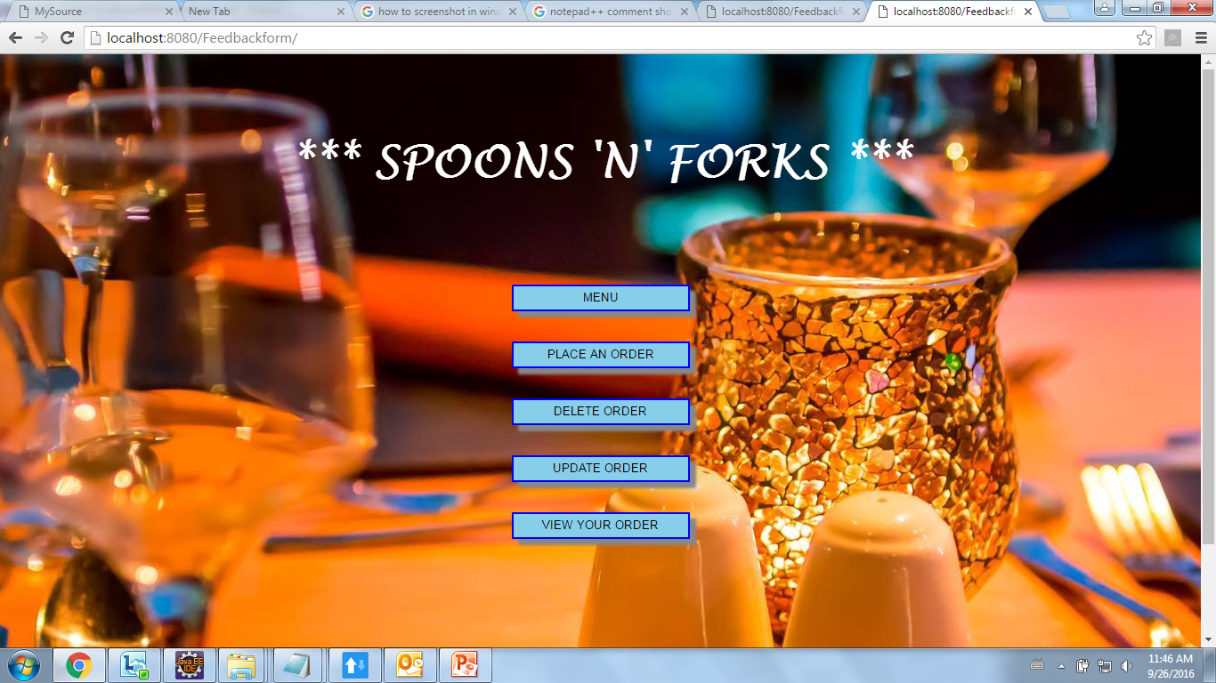
OVERALL VIEW

Slide 7
MENU
This button will display the entire menu list to the customer
The items are displayed along with their corresponding cost.

Slide 8
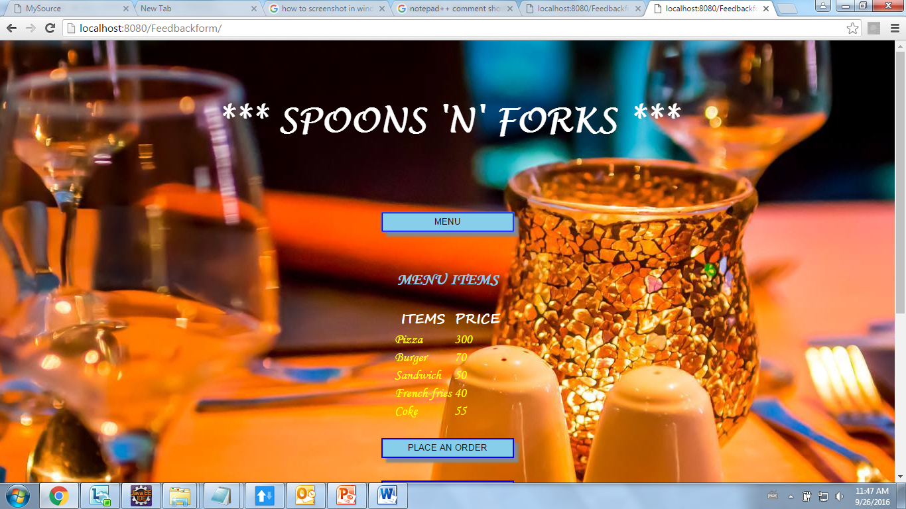

Slide 9
PLACE AN ORDER
This button has 2 text boxes where you can insert the item name and the corresponding quantity.
Once you are done with it,you can click on “CONFIRM ORDER”.
When you confirm the order,a unique ORDER ID is generated,which you can later use for updating or cancelling your order.

Slide 10
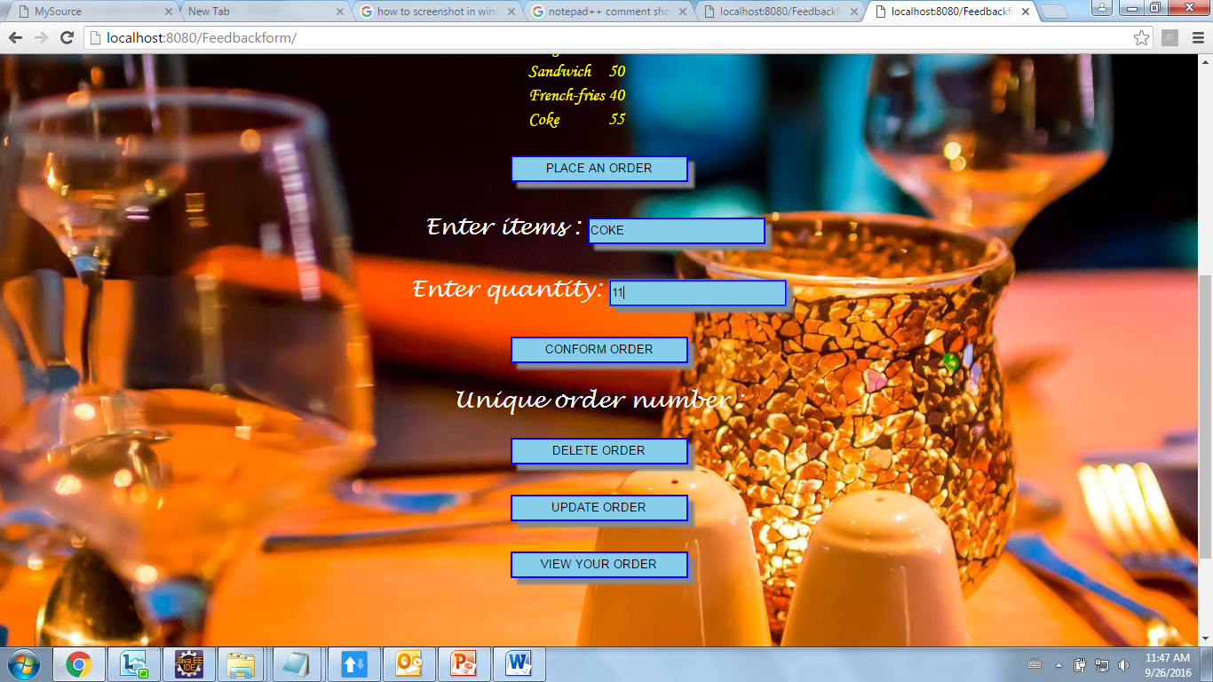

Slide 11
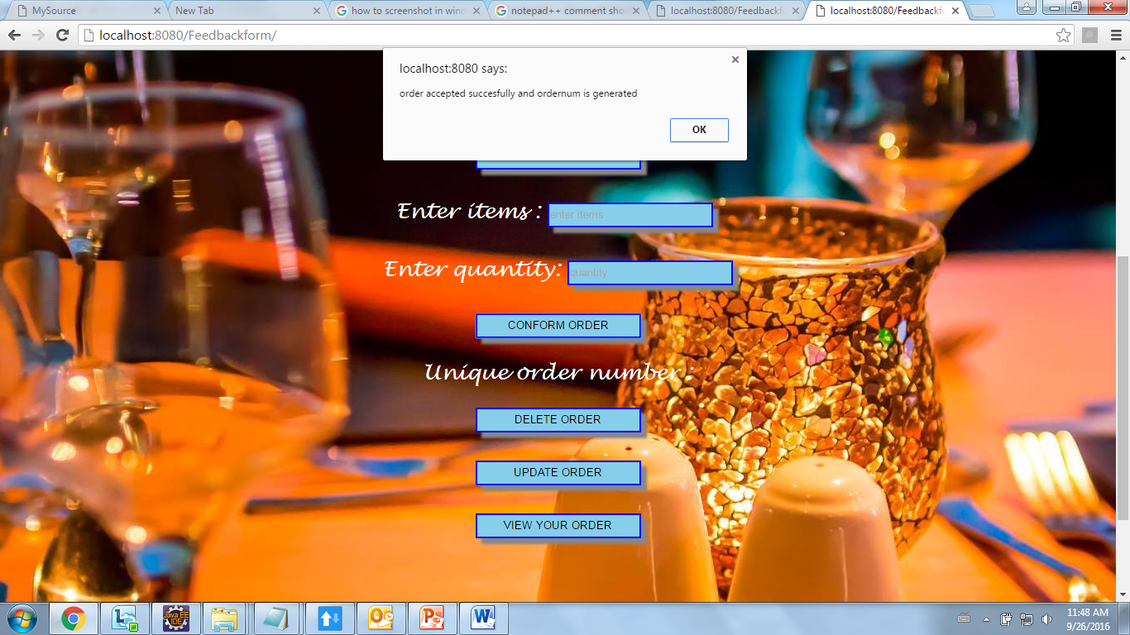
Alert box is displayed on confirmation of your order

Slide 12
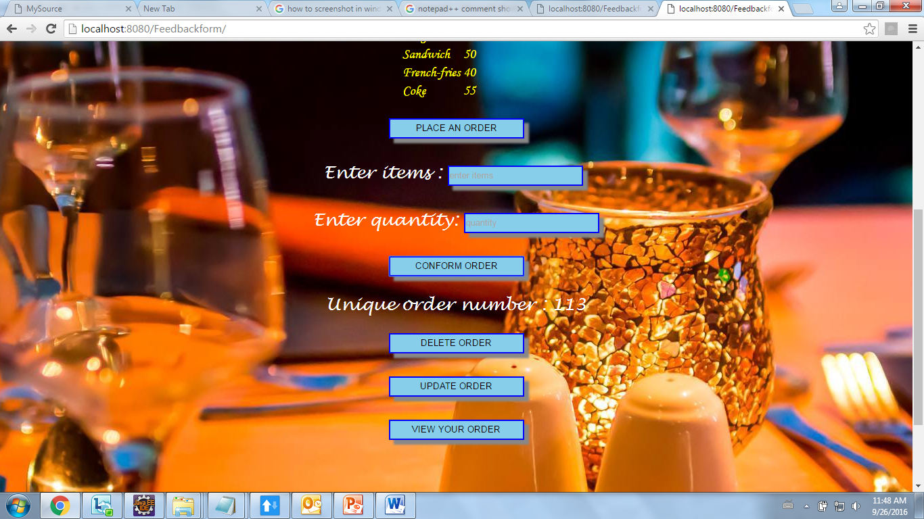
Unique ORDER ID is also generated.

Slide 13
UPDATE AN ORDER
You will be asked to enter your ORDER ID.
Then you can update the items and the quantity of that item.

Slide 14
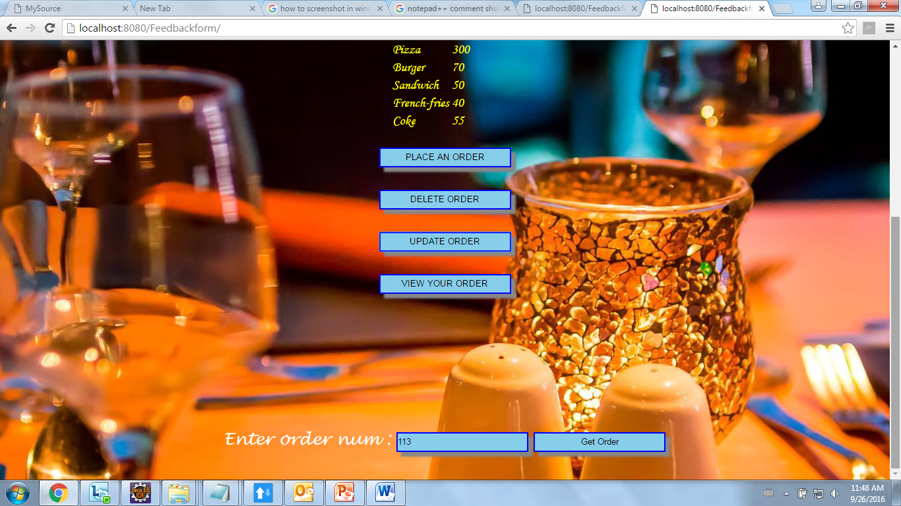

Slide 15
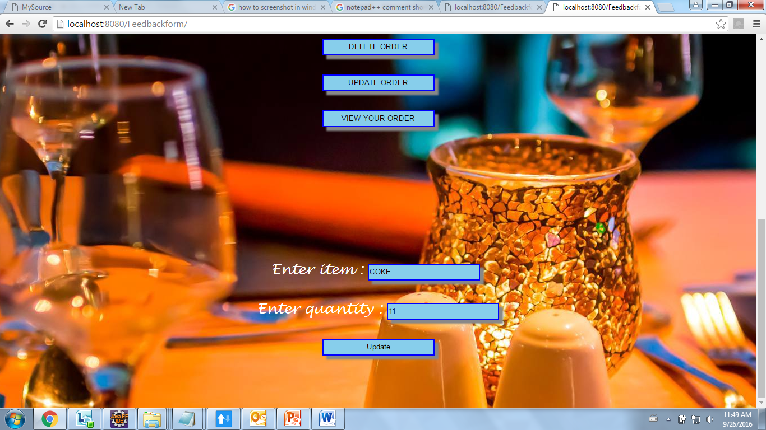

Slide 16
CANCEL AN ORDER
When you enter your order number and click on delete order button,your order is deleted
You will be notified with an Alert box

Slide 17
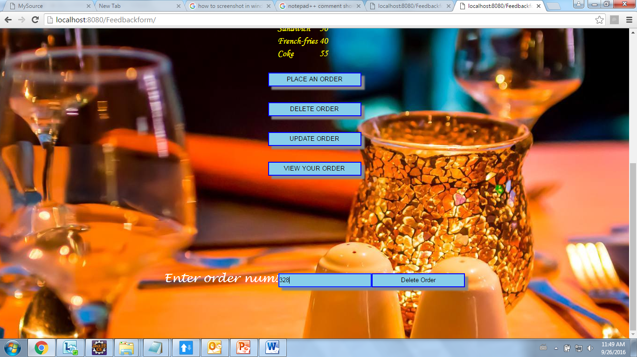

Slide 18
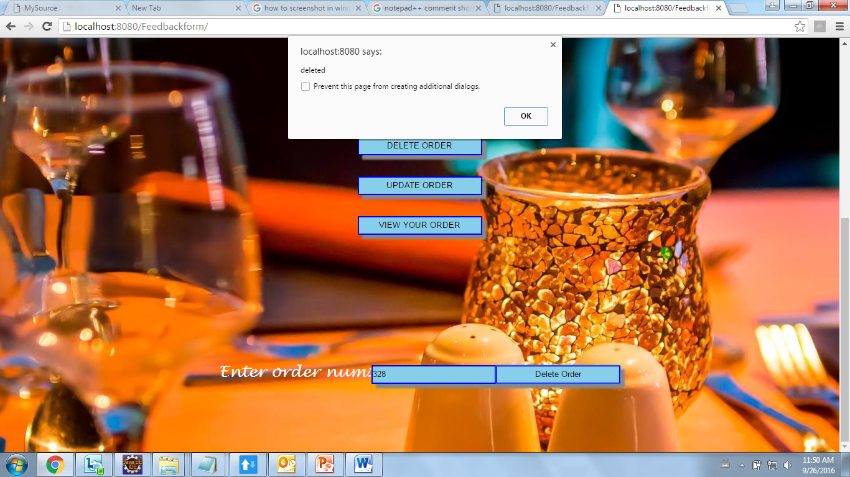

Slide 19
VIEW YOUR ORDER
Entering your ORDER ID and clicking on Get order will display
1.An Alert box with message “Record Not Found” if there is no such order no (else)
2.The details of the orders with respect to that particular order no

Slide 20
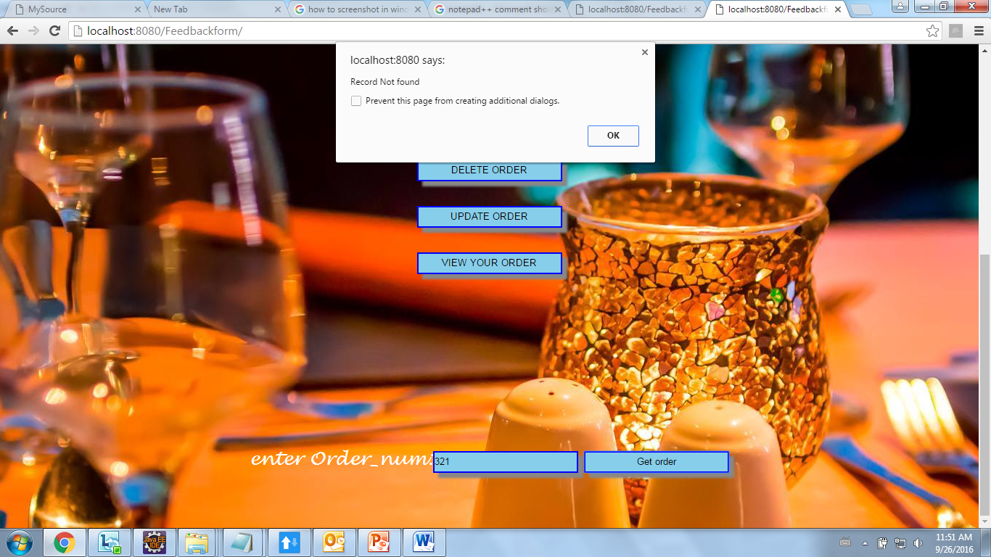

Slide 21
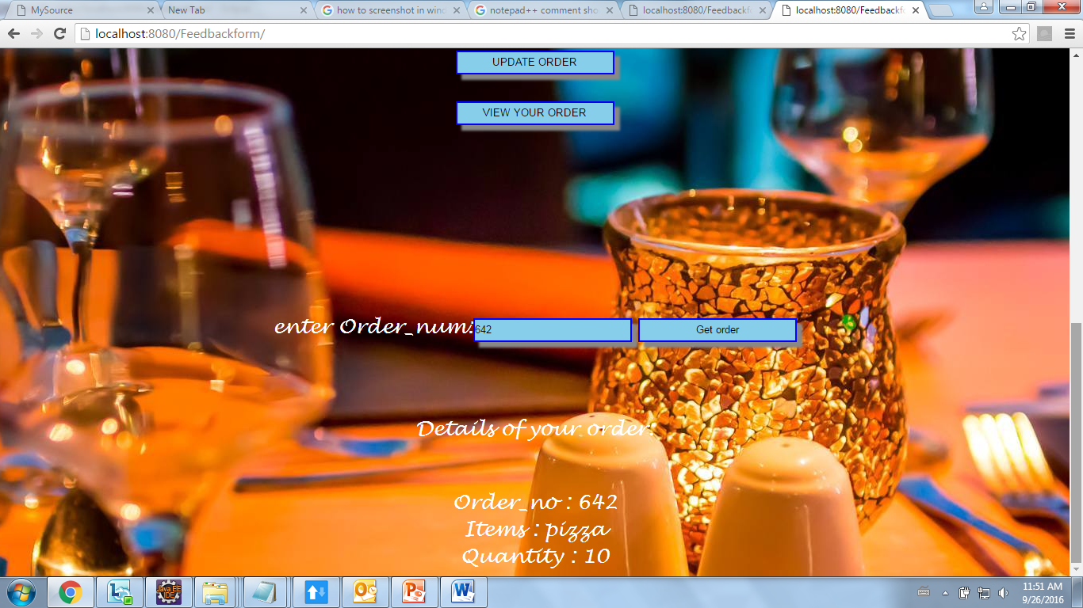

Slide 22
Right click on the screen and select “Open hyperlink” option to view a working model of the project

Slide 23
THANK YOU

